Slide 1
SIT105 – Thinking Technology and Design Class 03
Credibility &
Social Media
Dr. Frank Jiang
Frank.Jiang@deakin.edu.au

Slide 2

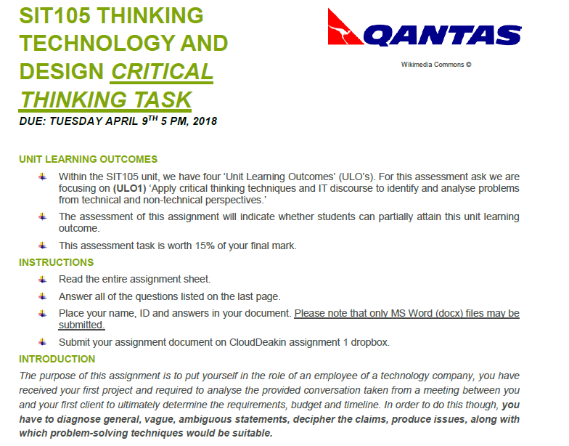

Slide 3
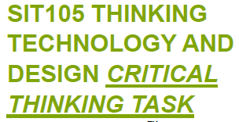
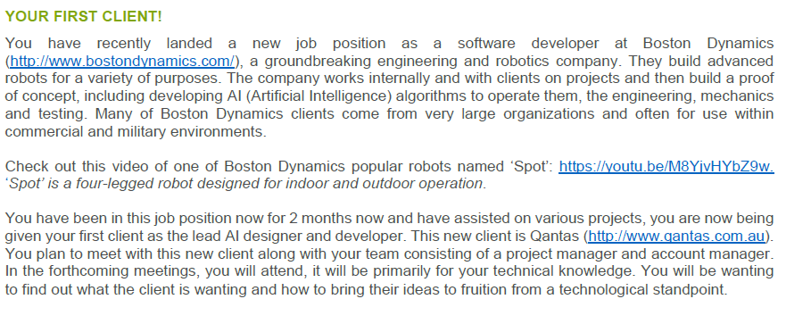
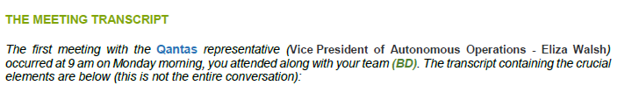

Slide 4
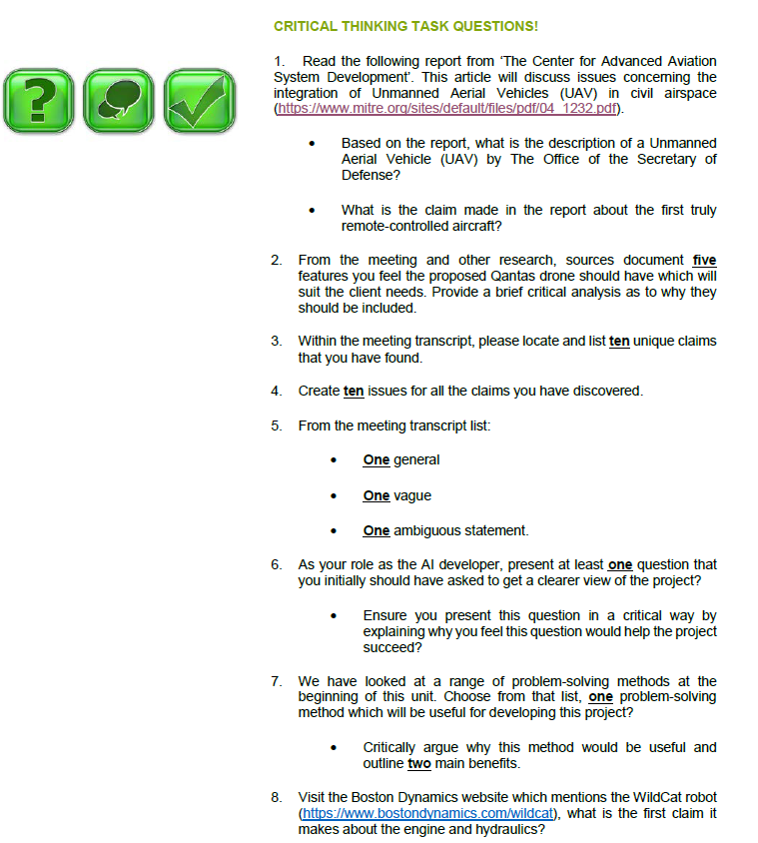

Slide 5
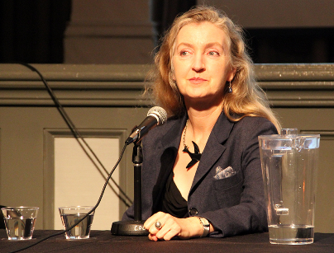
Critical Thinking Quote of the Week
“Credibility is a basic survival tool.”
Credibility can influence people's behaviours, patterns and thoughts. It can help determine if something or someone is trustworthy and believable.
Rebecca Solnit is a famous writer who lives in San Francisco, California. She has written on a variety of subjects, including the environment, politics, place, and art.

Slide 6
When there is no argument or support for a claim, it has to be evaluated through credibility!
So This Week Let’s Look At Credibility.
This week’s ULO – [1] Apply critical thinking techniques and IT discourse to identify and analyse problems from technical and non-technical perspectives.

Slide 7
Credibility in Business: “Your most important asset!”
Without credibility, everything you say to investors, potential partners or even your employees can be questioned.
After you graduate and look to start your own business: What do you think sells your company to the outside world? A promising idea? A great founding team? A solid intellectual property (IP) portfolio?
These are great but….credibility may be the most important asset, especially for a start-up company.
Credibility is the indicator with which others judge you and, by extension, your company. It drives your ability to raise capital, attract partners and hire the best employees.
Source: Nature Magazine http://www.nature.com/bioent/2009/090801/full/bioe.2009.8.html

Slide 8

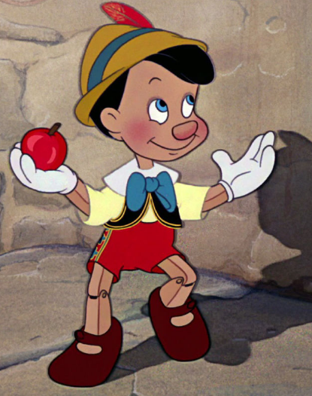
Credibility
This is one of the most useful topics of the course!
For study and for life in general
Knowing how to critique and understand and evaluate information is important!
This topic is really about whether claims are true or not!
So the careful determination of whether a claim is true or not…
We need to verify the line of reasoning and ideas, that leads to the source of a claim (person or info)

Slide 9
Credibility
A claim is something that in principle can be true or false
With a focus on the verification or lack there of claims/statements
Truth is not a clear concept!
For the purpose of the class lets look at credibility in the sense as to what can be verified by science
Some things are true, but how scientifically?

Slide 10
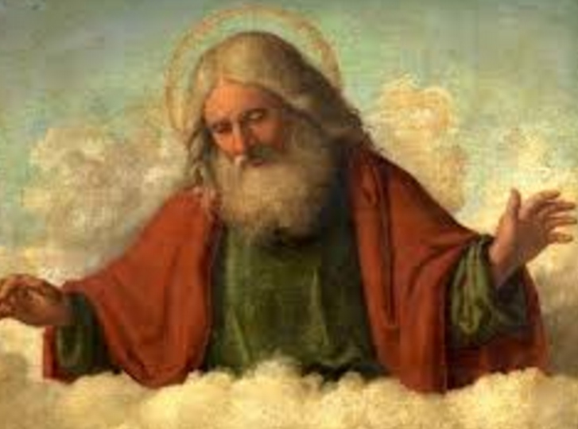
Credibility
As humans we don’t normally justify our beliefs very often
So after today’s line of thinking you will notice which beliefs you have accepted blindly and which ones you have followed scientifically with justification
Some claims are not verifiable, some of these will be related to metaphysical or afterlife… and that is fine!
Not all claims have to be verified, you can have faith in religious beliefs…That is fine!
However when you start making wild kinds of claims that can be verified (you enter the field of reason and logic) problems can occur!

Slide 11
Credibility: Religious Discussion
Your Task!
Spend 5-minutes with the person next to you on these questions below.
Is there any condition under which you can verify if god exists?
Or is it impossible at the current moment?
Could anything happen right now to change your belief in god? Whether believing or not believing?

Slide 12
Has There Been Examples in the Public Sphere, Where Credibility Has Been Questioned?

Slide 13
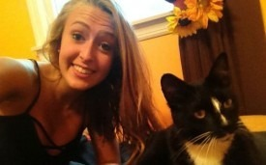
Police: Teenage Girl's Viral Tweet Was Kidnapping Hoax
A 16-year-old girl who mysteriously disappeared after tweeting that someone was in her house is now being accused of faking her own kidnapping.
Kara Alongi urgently asked her Twitter followers on Sunday night to call 911, saying "there is someone in my house [sic]."
It didn't take long for the Internet to rally around her message. Not only did #HelpFindKara trend worldwide on Twitter, nearly 34,000 people retweeted her call for help to raise awareness about the incident.
She also gained about 95,000 followers by Monday morning and the local police department received more than 6,000 calls after her tweet went viral.
But now, police are saying that that the tweet was actually a hoax!
When Alongi's family returned home about an hour later, they called authorities who found no traces of forced entry or stolen property, according to the New Jersey Star-Ledger.
Source: http://mashable.com/2012/10/01/teenage-girl-tweet-kidnapping/

Slide 14
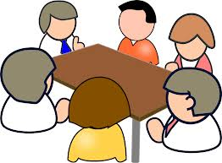

Following the News Article …Debate!
Your Task!
Spend 5-minutes with the person next to you and 2 people behind you to discuss these questions.
1. Who caused the most issues here?
The girl for tweeting about this fake intruder?
The users of Twitter for believing a claim from a random Twitter account… and then calling the police?
Both?
2. How should it have been handled?

Slide 15
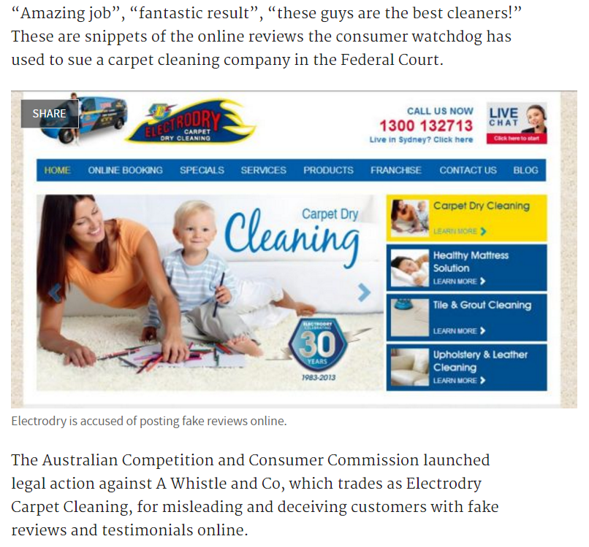
ACCC cracks down on fake reviews, sues Electrodry
Source: http://www.smh.com.au/digital-life/digital-life-news/accc-cracks-down-on-fake-reviews-sues-electrodry-20140702-zstij.html

Slide 16

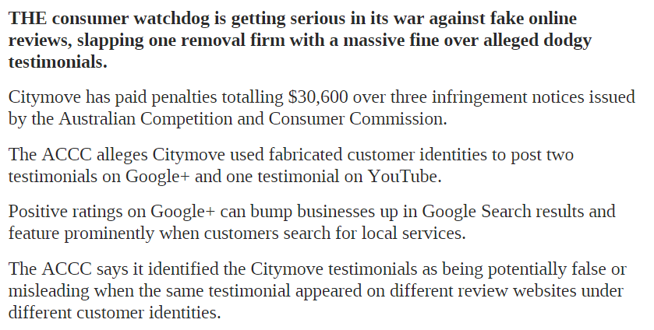
ACCC cracks down on fake reviews
Could we use a technical approach to assess the credibility in occurrences like this?
Source: http://www.news.com.au/finance/small-business/accc-cracks-down-on-fake-reviews/news-story/eb8d6c1fc7a2599a4ed4ec26ffe9fb2a

Slide 17
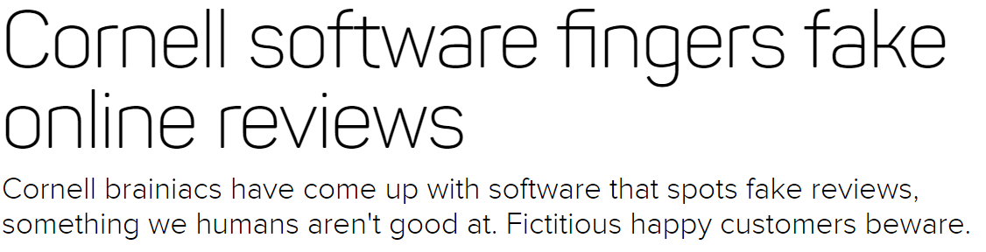
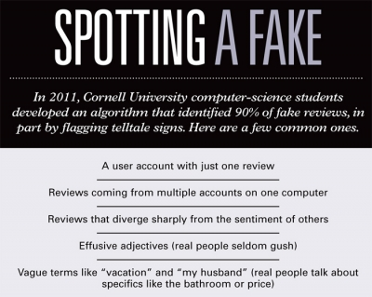
Source: https://www.cnet.com/news/cornell-software-fingers-fake-online-reviews/

Slide 18
We Know That The Internet Is Littered with Fake Information…
How Can We Determine Credibility?

Slide 19
Suspicious Credibility
Where did it come from?
The credibility of:
a claim can be suspicious
a claim’s source can be suspicious
Example #1 F1 RedBull Racing team won $101.5 million dollars in the 2013 season.
Source: Joe Saward F1 Journalist: http://bleacherreport.com/articles/1955397-formula-1-prize-money-what-are-the-rewards-per-race-and-per-season
Example #2
Bart Simpson: “I won that money in a science competition”.
Lisa Simpson: “I won that money in a science competition”.
Who is more credible?
Notes:
http://www.deakin.edu.au/careers-at-deakin/assets/resources/why-deakin/benefits/salary-rates-casual.pdf

Slide 20

Degrees of Credibility
Credibility has levels of degrees, it is not clear cut yes or no.
It can giving you reasons to be: suspicious, quick to believe, or any level in between.
There are degrees of credibility for both:
Claims
Sources of claims
Examples:
Surgical robots are safer than human surgeons
Autonomous cars are safer than human operated cars
Scientist says the Earth is getting hotter
Politician says the Earth is getting hotter
Claims (red) and claims with sources (blue)

Slide 21
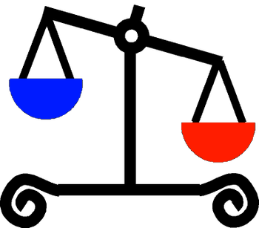
Interested Party
An interested party stands to gain in our belief in a claim.
E.g. things like money or fame
A disinterested party has no interest in our belief in a claim.
Much more believable if they don’t stand to gain anything! But still not 100%.
A salesman may be an interested party.

Slide 22
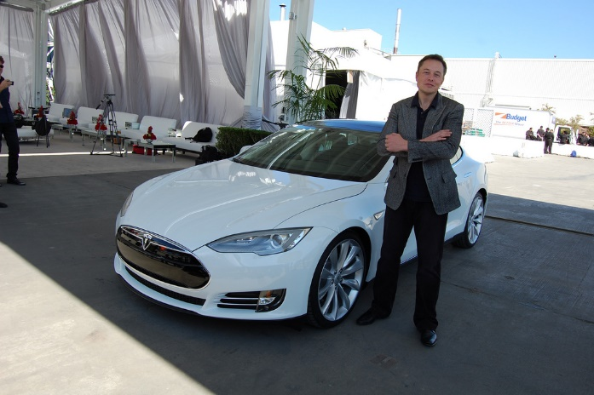
Interested Party (person or group)
Interested parties are less credible than other sources of claims
Example: you want to buy a car.
“That 10 year old car runs perfect” said salesman.
“That 10 year old car runs perfect” said mechanic.
Which person/source do you trust more and why?
Your Task!

Slide 23

Credibility / Suspicion Table
Claim Source Suspicion
High Credibility High Credibility Low
Lacks Credibility High Credibility Medium
High Credibility Lacks Credibility Medium
Lacks Credibility Lacks Credibility High
If we combine the claim and the source together.
We can work out the suspicion level.
E.g. High credibility claim but low credibility source is medium suspicion level.

Slide 24

Claims Lacking Credibility
A claim lacks credibility:
When it conflicts with our observations
Nick has purple hair.
When it conflicts with what we think we know (background knowledge)
2 + 3 = 11
When it conflicts with credible claims
The Sun revolves around the Earth.

Slide 25
Now Let’s Look At The Theme Of This Week.
Credibility With Regards To Social Media!

Slide 26
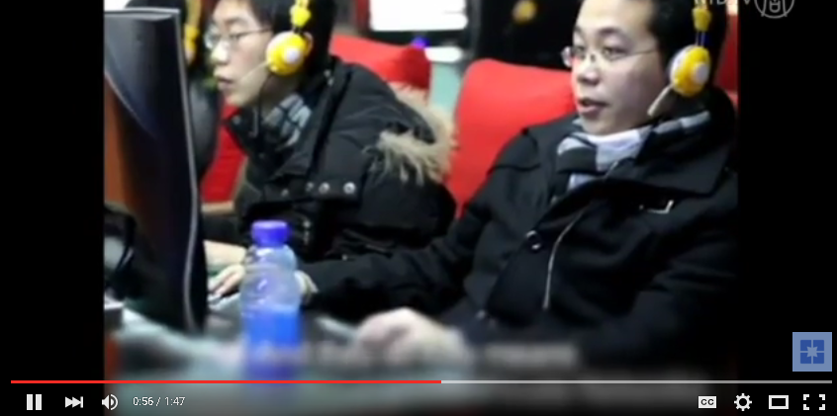
China Cracks Down on Internet Rumors to Protect "Social Media Credibility"
Source: https://youtu.be/4YYGOVcukmE

Slide 27

Social Media & News (PCQ Activity)
Let’s fill out this table to determine the pro’s, con’s and any questions as to whether social media is a benefit or hindrance to breaking news.
Pro’s | Con’s | Questions
Get notice of new events very quickly (e.g. Twitter). | You can’t rely on the credibility of all the sources. | If I don’t rely on Social Media, how do I find out news and events in the quickest way possible?

Slide 28
Social Media Accuracy Checklist!
Here are some items to consider that can help determine authenticity of Social Media posts:
Location of the source - are they in the place they are tweeting or posting about?
Network - who is in their network and who follows them? Do I know this account?
Content - Can the information be corroborated from other sources?
Contextual updates - Do they usually post or tweet on this topic? If so, what did past or updated posts say? Do they fill in more details?
Age - What is the age of the account in question? Be wary of recently created accounts.
Reliability - Is the source of information reliable?
Can you think of any others?
Source: Sheridan Libraries - Johns Hopkins University http://guides.library.jhu.edu/c.php?g=202581&p=1335031

Slide 29
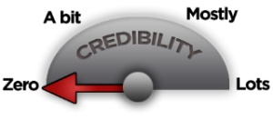
In Conclusion…
Credibility can be a survival tool and maybe your most important asset for your career and life.
Interested parties can influence a claims credibility.
Review the credibility table to see the suspicion level of a source.
China is cracking down on Internet rumours!
Sometimes a single person can cause a melt down on Twitter from fake Tweets!
Cornell University students found a way to spot online fake reviews and for social media Johns Hopkins University has established guidelines for assessing social media posts.

Slide 30
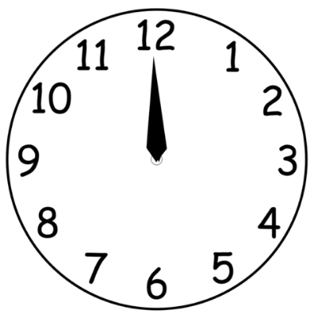

Take 5
From today’s class and our group discussions.
Take 5 minutes to jot down the main things you learned today…. What are your ‘takeaways’.

Slide 31

End of Class!
Any Questions?
Readings:
Measuring Social Media Credibility: A Study on a Measure of Blog Credibility
http://www.instituteforpr.org/wp-content/uploads/BlogCredibility_101210.pdf
The online task for week 3 is to find a non-credible news article that was blown out of proportion and post it & discuss on the Week 3 CloudDeakin discussion board!

